Slide 1
YARN Yet Another Resource Negotiator

Slide 2
Hadoop 1.0
Master: JobTracker (JT)
Worker: Tasktracker (TT)
Fixed # of map slots and reduce slots
Master Node
(JobTracker)
client
Worker Node
(TaskTracker)
Worker Node
(TaskTracker)
Worker Node
(TaskTracker)
Notes:
Add a figure to show the system diagram

Slide 3
Limitations of Hadoop 1.0 Architecture
Single NameNode is responsible for managing entire namespace for Hadoop Cluster.
It has a restricted processing model which is suitable for batch-oriented MapReduce jobs.
Hadoop MapReduce is not suitable for interactive analysis.

Slide 4
Hadoop 1.0 is not suitable for machine learning algorithms, graphs and other memory intensive algorithms.
MapReduce is responsible for cluster resource management and data processing.
HDFS limitation: Namenode saves all its file metadata in main memory. It can quickly become overwhelmed with load on the system increasing.

Slide 5
YARN
Apache Hadoop YARN is a sub-project of Hadoop 2.x.
Hadoop 2.x is YARN based architecture.
It is a general processing platform.
YARN is not constrained to MapReduce only.
Multiple applications can share a common resource management.
Hadoop supports various types of processing such as Batch, Interactive, Online, Streaming, Graph and others.

Slide 6
Hadoop 2: HDFS
Hadoop 2 consists of two major components
(1) Namespace: It takes care of file related operations such as creating files, modifying files and directories.
(2) Blocks storage service: It handles Data node cluster management and replications.

Slide 7
Hadoop 2: Features
1. Horizontal Scalability
HDFS federation uses multiple independent Name Nodes for horizontal scalability.
2. High availability
It is obtained with the help of Passive Standby Name Node.
Active-Passive Name node handles failover automatically.

Slide 8
Active and passive NameNode Interaction
Active Name Node
Passive Name Node
Shared Edit Logs

Slide 9
Hadoop 1.x versus Hadoop 2.x
MapReduce
(Data Processing)
Others(Data processing)
MapReduce
(Cluster Resource Management & Data Processing)
YARN
(Cluster Management)
HDFS
(Redundant, reliable storage)
HDFS
(Redundant, reliable storage)

Slide 10
Hadoop 2 YARN: Taking Hadoop beyond Batch
We can interact in multiple ways to get predictable performance and quality of services.
Not only batch oriented processing, it supports interactive, streaming and in-memory analytics also.
Batch (MR)
Interactive (TEZ)
Online (HBASE)
Streaming (STorm)
In-memory (spark)
HDFS 2

Slide 11
Fundamental Idea
The fundamental idea behind this architecture is splitting the JobTracker responsibility of resource management and job scheduling into separate daemons.
Daemons that are part of YARN architecture are described below.
Global Resource Manager: Its main responsibility is to distribute resources among various applications in the system.
It has two main components:

Slide 12
(a)Scheduler: The pluggable scheduler of Resource Manager decides allocation of resources to various running applications.
(b)ApplicationManager:
It accepts job submissions.
Negotiates resources(container) for executing the application specific ApplicationMaster.
Restarting the ApplicationMaster in case of failure.

Slide 13
2. NodeManager:
This is a per-machine slave daemon.
NodeManager responsibility is launching the application containers for application execution.
NodeManager monitors the resource usage such as memory, CPU, disk, network etc.
It then reports the usage of resoures to the global ResourceManager.
3. Per-application ApplicationMaster:
This is an application specific entity.
Its responsibility is to negotiate required resources for execution from the ResourceManager.
It works along with the NodeManager for executing and monitoring component tasks.

Slide 14
Basic Concepts
Application: Application is a job submitted to the framweork.
Containers:
Basic unit of allocation
Fine-grained resource allocation across multiple resource types(Memory, CPU, disk, network etc)
Replaces the fixed map/reduce slots.

Slide 15
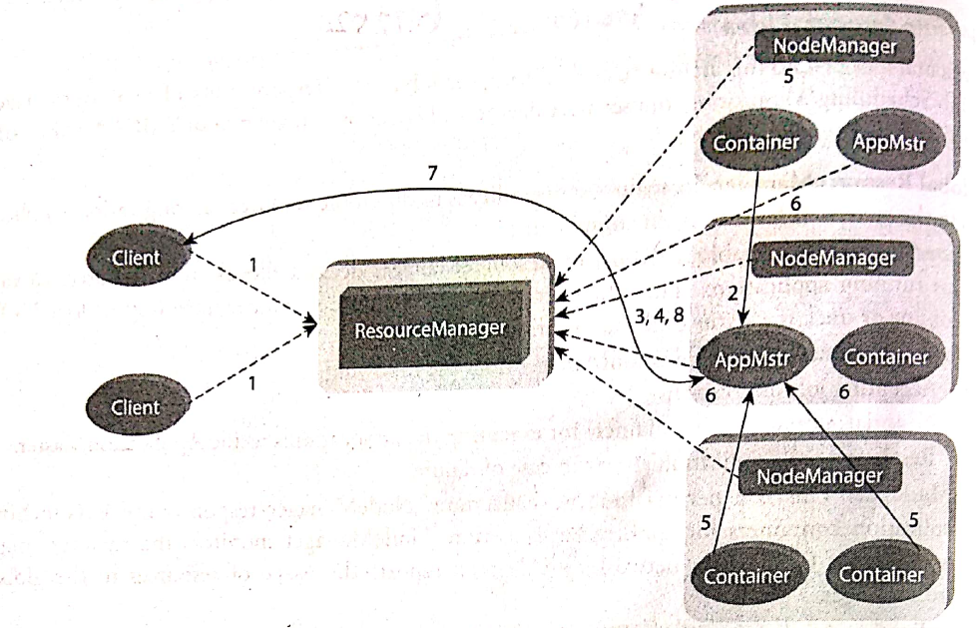
YARN Architecture

Slide 16
The steps involved in YARN architecture are as follows
A client program submits the application which includes the necessary specifications to launch the application-specific ApplicationMaster itself.
The resource manger launches the application master by assigning some container.
The applicationmaster on boot-up registers with the resourcemanager. This helps the client program to query the resourcemanager directly for the details.

Slide 17
4. During the normal course, applicationmaster negotiates appropriate resource containers via the resource-request protocol.
5.On successful container allocations, the ApplicationMaster launches the container by providing the container launch specification to the NodeManager.
6. The NodeManager executes the application code and provides necessary information such as progress, status etc to its applicationmaster via an application-specific protocol.

Slide 18
7. During the application execution, the client that submitted the job directly communicates with the applicationmaster to get status, progress updates, etc, via an application-specific protocol.
8. Once the application has been processed completely, ApplicationMaster deregisters with the ResourceManager and shuts down, allowing its own container to be repurposed.

Slide 19
Interacting with Hadoop Ecosystem
PIG:
Pig is a dataflow system for Hadoop. It uses Pig Latin to specify data flow.
Pig is an alternative to MapReduce Programming.
It abstracts some details and allows you to focus on data processing.
It consists of two components:
1. Pig Latin: The Data processing language
2. Compiler: To translate Pig Latin to MapReduce Programming

Slide 20
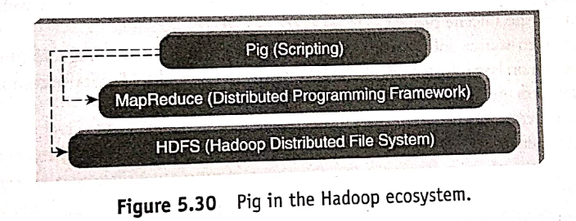

Slide 21
HIVE:
Hive is a Data Warehousing Layer on top of Hadoop.
Analysis and queries can be done using an SQL-like language.
Hive can be used to do ad-hoc queries, summarization, and data analysis.

Slide 22
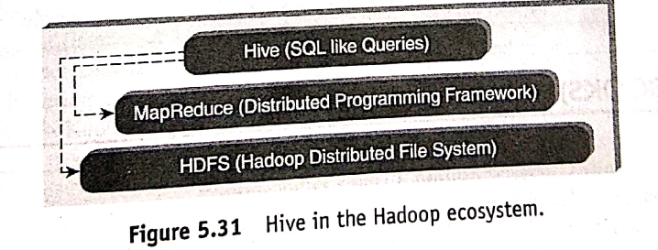

Slide 23
SQOOP:
Sqoop is a tool which helps to transfer data between Hadoop and Relational Databases.
Sqoop helps to import data from RDBMS to HDFS and vice-versa.

Slide 24
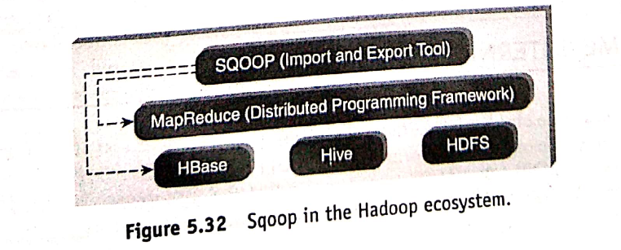

Slide 25
HBASE:
HBase is a NoSQL database for Hadoop.
HBase is a column-oriented NoSQL database.
Hbase is used to store billions of rows and millions of columns.
Hbase provides random read/write operation.
It also supports record level updates which is not possible using HDFS.
HBase sits on top of HDFS.

Slide 26
